Slide 1
Blog Post Prediction
Team 10
Avinita Shetty
Vishwa Shah
Jun Wu

Slide 2
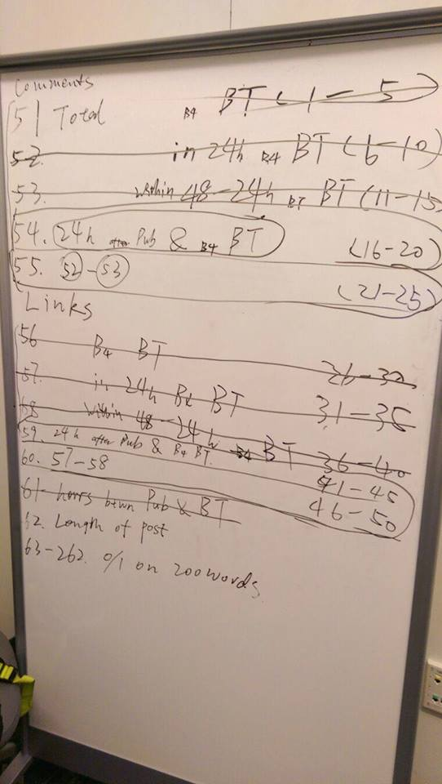
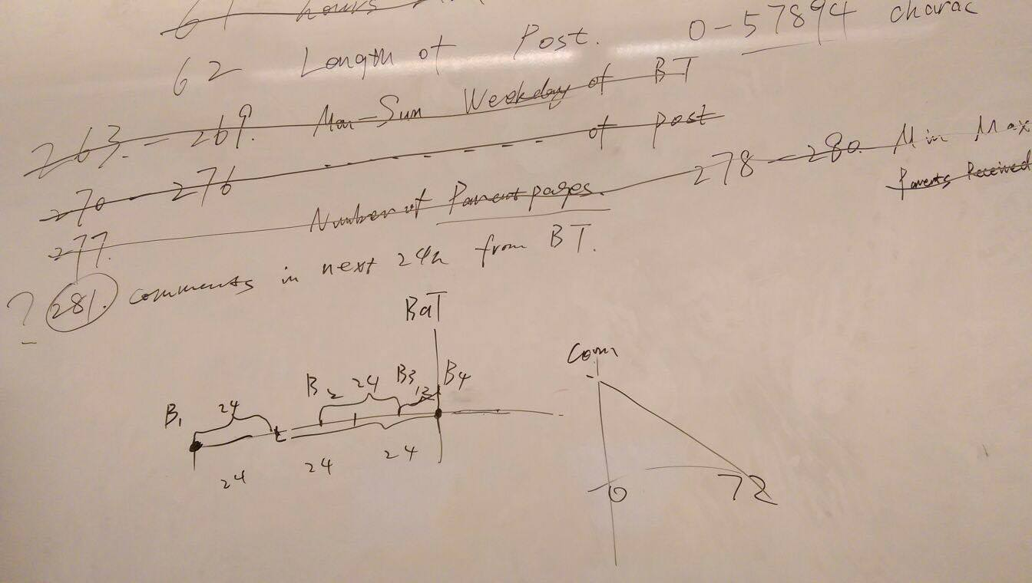
4.1 Understand Data Set
Learn 281 Columns
Basic group
Parent group
Bag of words
Make assumptions
Positive
Negative
Uncertain

Slide 3
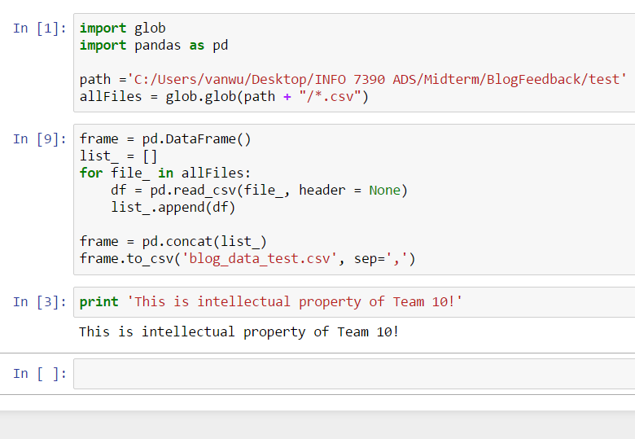
4.2.1 Modeling Overview
Pre-processing
Python: Combine test dataset
Data quality check
Round 1
Model 281
Problem with Random Forest
Variable selection
Round 2
Model 81

Slide 4
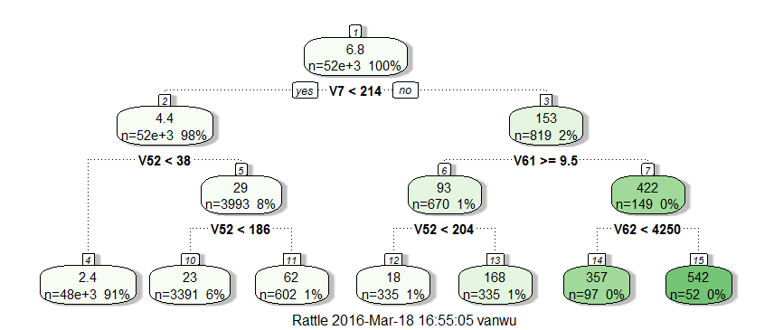
4.2.2 Modeling Details
Multi Linear Regression
LM, Summary
CART
rpart, fancyRPlot
method="anova"
Random Forest
randomForest
ntree, mtry

Slide 5
4.3 Performance evaluation
Model 281
Linear Regression: 21.96
CART: 27.06
Random Forest: 28.39
Model 81
Linear Regression: 25.24
CART: 24.39
Random Forest: 22.61

Slide 6
4.4 Recommendation
“It depends”
Variable data type
Number of variables
However, in this case..
For comprehensiveness & best fit
For parsimony & efficiency

